Slide 1
RTC Governance User Guide
Ryan Thompson and Karla Train

Slide 2
Contents
Accessing RTC
Getting started with RTC
Instructions on how to book your ATA/ARB/SDB slot
Work arounds – user fixes to RTC – hints and tips
Instructions on how to book your SDB slot
Notes:
Training Materials – To Do
Create a Question
ADMIN Assign Reviewer/Approver
ADMIN Assign Domain Reviewers
ADMIN Timelines/Iterations
ADMIN Add users

Slide 3
Accessing RTC

Slide 4
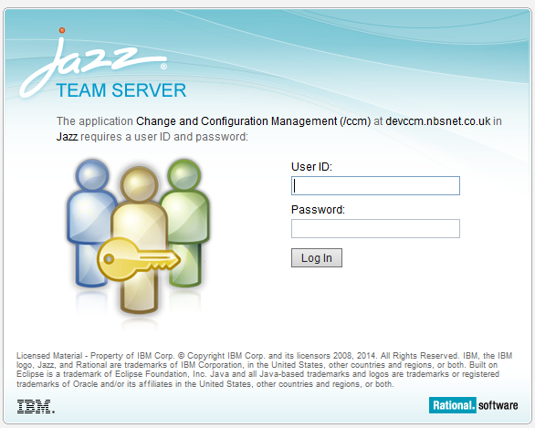
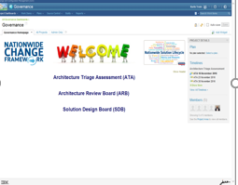


Accessing RTC
All user will not need to complete and submit an E-URF form to access RTC.
1. Open the Governance Dashboard
2. Enter your NBS Windows username (P/C/T Number) and password, then click ‘Log In’
Note: The Governance Dashboard is then displayed

Slide 5
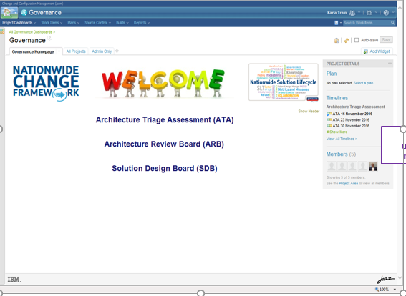
The Governance Home Page
By clicking onto the relevant Board meetings, ATA, ARB or SDB you will be taken to the individual meeting’s home pages.
List of upcoming meetings

Slide 6
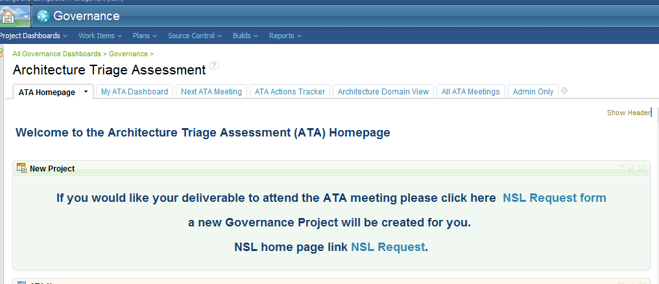
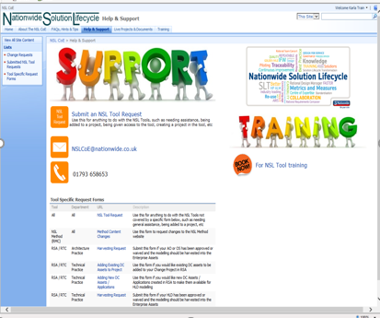
All new booking’s have to be created by the NSL team
By clicking onto the ‘NSL Request Form’ link you will be taken to the NSL Support page.
Click on ‘Submit an NSL Tool Request’ this will take you to the next stage and you will need to complete the submission form.

Slide 7
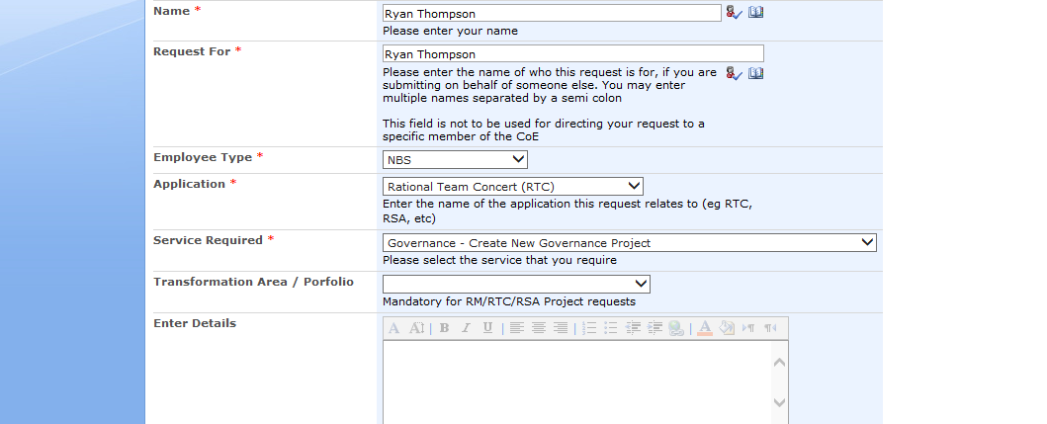
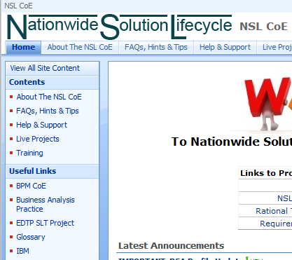
Completing the NSL submission form
1. Click here to submit a NSL Tool Request to have a project created
Ensure you complete the following fields as follows:
Application Rational Team Concert (RTC)
Service Required Governance – Create New Governance Project
Enter Details Owner, Project Name, Project Code
2. The NSLCOE will email you to confirm your Project has been created
Note: This only needs to be done once per Project.

Slide 8
Getting started - RTC

Slide 9
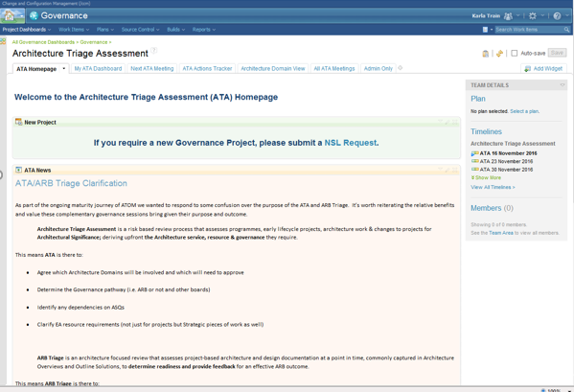
ATA, ARB, SDB Home Page
The ATA, ARB and SDB home page will show key information, confirming when the next meetings are planned, quick view tabs and a quick lick to the NSL team.

Slide 10
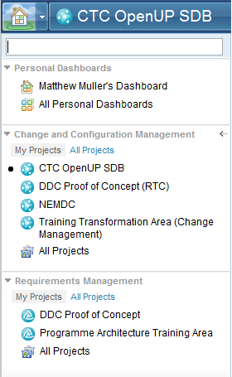
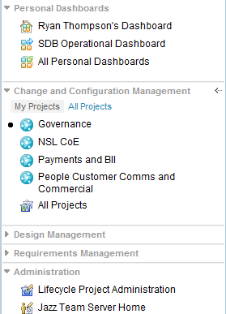

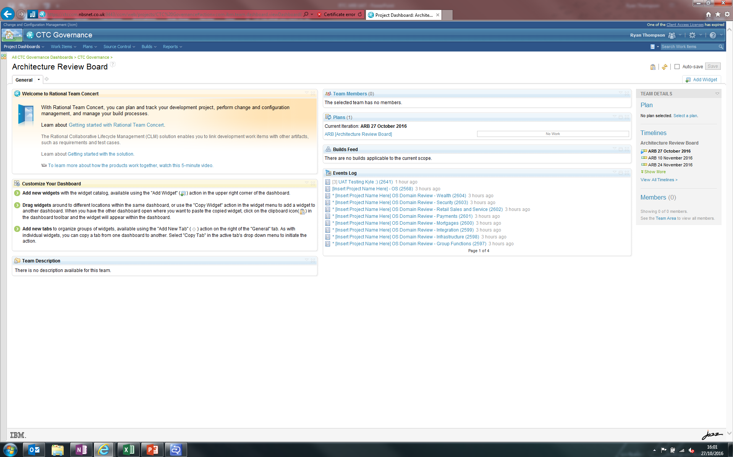
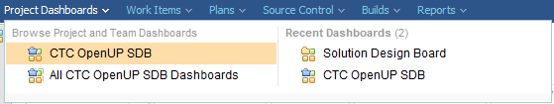
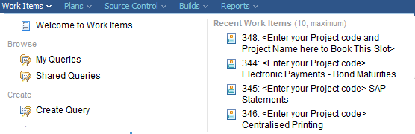

RTC Overview
My Projects
- My Dashboard
- RTC / CCM Projects
- RM Projects
Search
- Quick Search
Project Dashboards
Current Dashboards
Recent Dashboards
Work Items
- Query
- Recent Work Items
Architecture Review Board
Solution Design Board

Slide 11
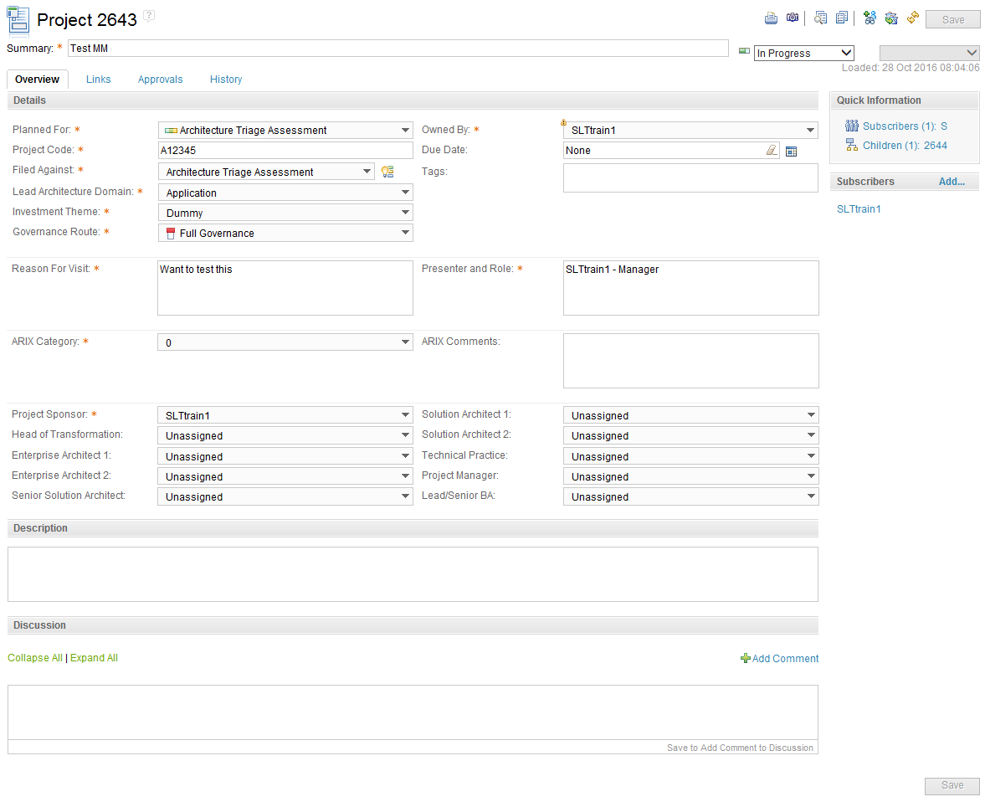
RTC Work Item Overview
Overview Tab
Define project name, code, type, those involved and a description.
Discussion allows for project comments to be recorded in a single location and provides email notifications to those subscribed.
Links Tab
Upload project documents.
Define subscribers, other than the creator and owner of the work item.
Approvals/Reviews Tab
Define reviewers, due date for reviewing documents and outcome of reviews.
History Tab
Lists all changes to the work item, such as stages of workflow and comments.
All changes are date time stamped and state who made the change, as well as providing a link to the relevant comment where available.
Workflow State
Defines the stage of the item, based on the Governance workflow.

Slide 12
Instructions

Slide 13
Instructions
Access RTC
Create a Project
View/Update a Project
Create a Deliverable
View/Update a Deliverable
Attend an ATA
Attend an ARB
Attend an SDB
Complete a Domain Review
Update/Resolve/Approve an Action
Notes:
Training Materials – To Do
Create a Question
ADMIN Assign Reviewer/Approver
ADMIN Assign Domain Reviewers
ADMIN Timelines/Iterations
ADMIN Add users

Slide 14
View/Update a Project

Slide 15
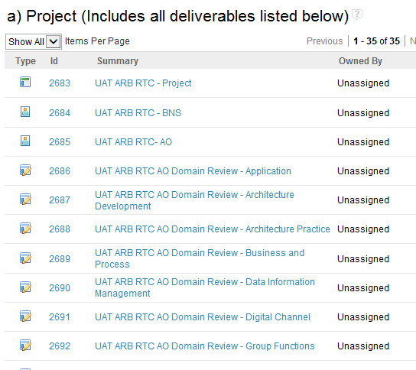
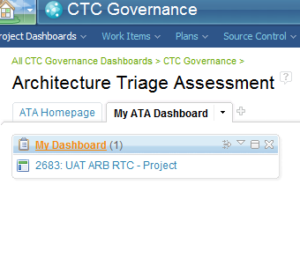
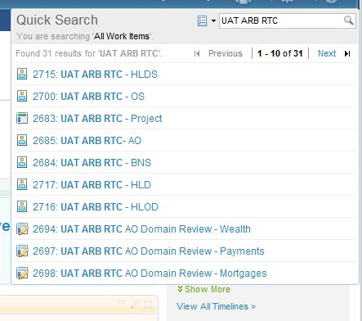
View/Update a Project 1/2
Option 1. If you have just created the Project, click on the Project work item
Option 2. Use My ATA Dashboard to view all ATA items owned by you
Option 3. Use the search feature which is
available in the top right of every page

Slide 16
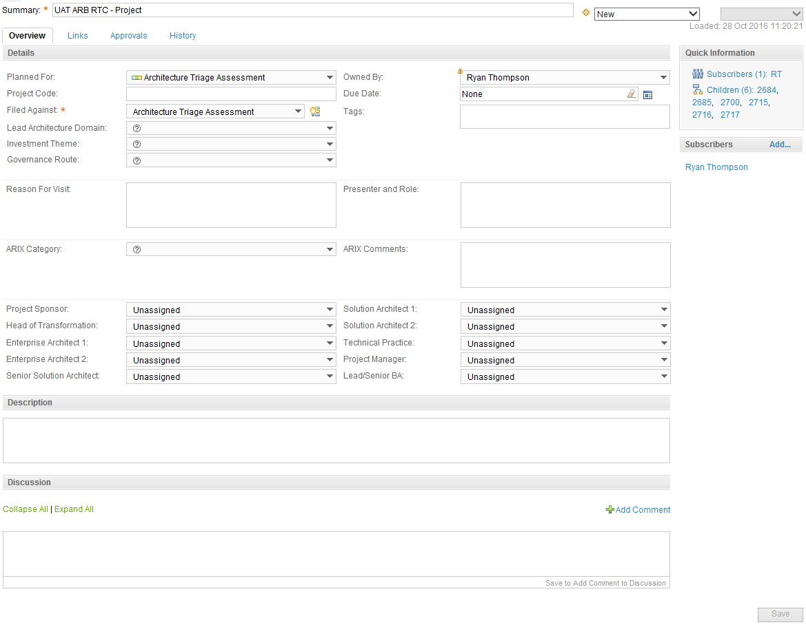

View/Update a Project 2/2
Project name
Current workflow state
Specify which meeting you wish to attend
Insert the project code
The main person responsible for updating the work item and attending ATA?
Governance body that is responsible for assessment
Which Architecture Domain is leading this project?
Define the Investment theme
Subscribers receive notifications each time an update/change is made
Why do you want to visit ATA/ARB?
Who will be attending and what is their role?
Full or Light Governance?
What is the ARIX Category?
Specify the date when documents, checklists, presentation slides etc need to be uploaded
Who is involved in the project
Is the ARIX more Business or IT weighted or is there anything else influencing the category?
Add a brief description of the project
Always click Save after making any changes
Add project related comments. Admin also use for reminders and notes.

Slide 17
Attend an ATA – First Steps

Slide 18
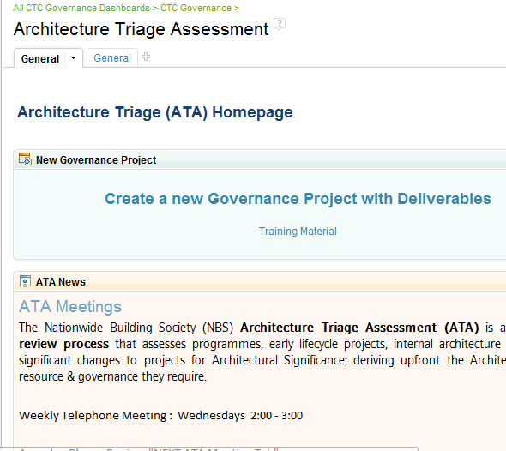
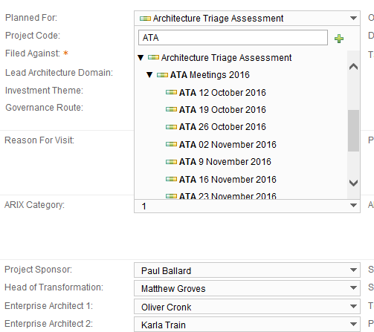
Attending an ATA - First steps - 1/3
1. Ensure the NSL team have created a project
See: Creating a project
2. Open your project
See: Viewing/Updating a Project
3. Specify which meeting you wish to attend by using the ‘Planned For’ field

Slide 19
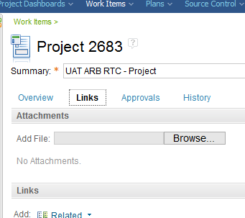
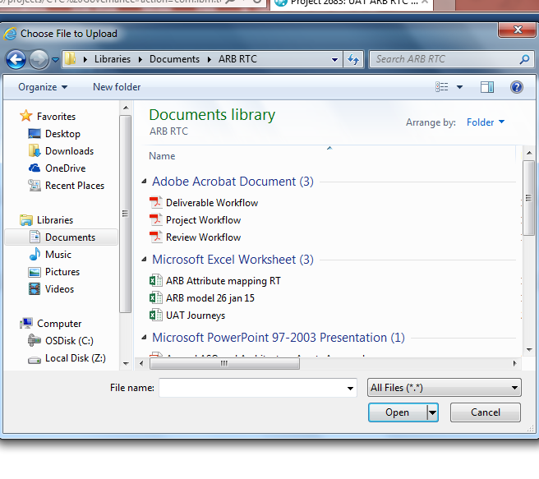
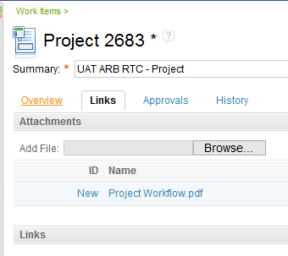
Attend an ATA – First Steps - 2/3
4. Click on the ‘Links’ tab
5. Upload your slides or supporting material by clicking ‘Browse…’ and then navigating to the required file followed by clicking ‘Open’
Note: Repeat step 5 per file
6. Click on the ‘Overview’ tab

Slide 20
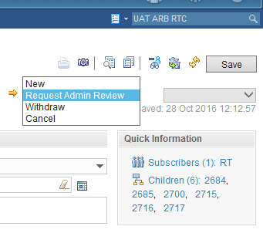
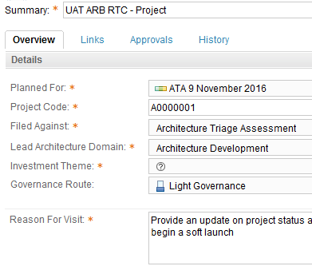
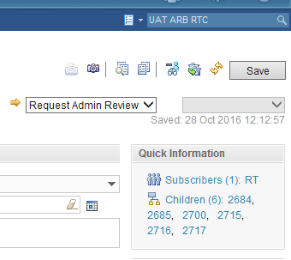
Attend an ATA – First Steps - 3/3
4. Update the workflow state from ‘New’ to ‘Request Admin Review’
5. Ensure you complete all mandatory fields as denoted by the orange asterisk
6. Click Save
Note: Changes only take affect when saved

Slide 21
Create a Deliverable

Slide 22

Create a Deliverable – AO, OS, HLD etc - 1/3
Warning!
Please check that a Project has not been created which contains the Deliverable before continuing.
Use either the My ATA Dashboard or Quick Search to check for existing projects
Note: A deliverable should only be created once, even if attending ATA/ARB/SDB more than once
Option 1. Use My ATA, ARB or SDB Dashboard to view all ATA, ARB and SDB items owned by you
Option 2. Use the search feature which is
available in the top right of every page
Note: If you require an AO or OS deliverable, you must request a Project first (See Creating a project)

Slide 23
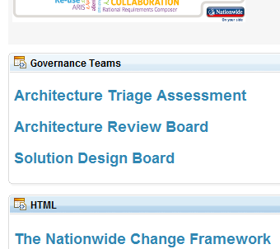
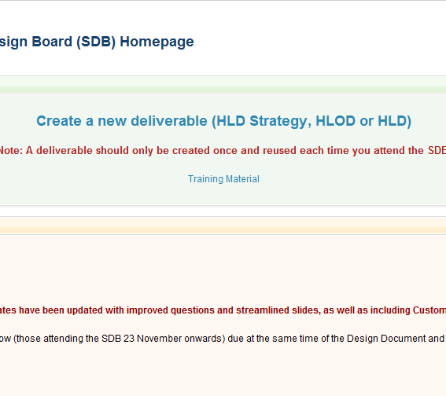
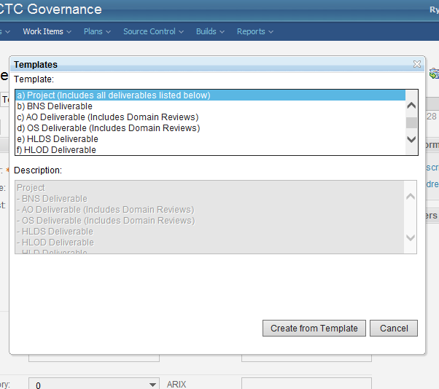
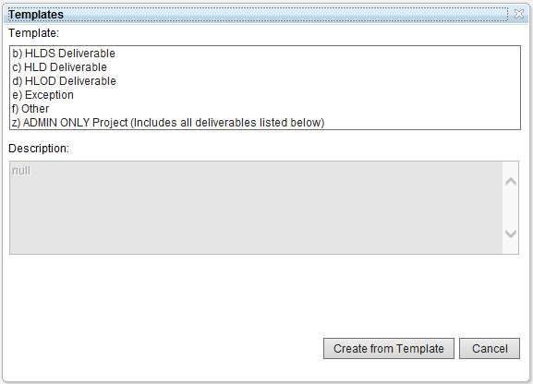
Create a Deliverable 2/3
1. Access the ‘Solution Design Board’ Homepage
2. Click ‘Create a new Deliverable (HLD Strategy, HLOD or HLD’
3. Select the required Deliverable and
then click ‘Create from Template’

Slide 24
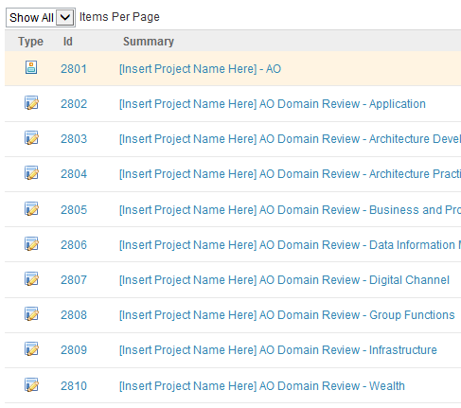
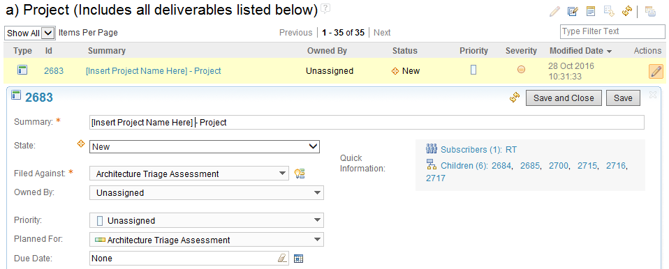


Create a Deliverable 3/3
1 of 1
HLD
Note: A list of all the work items created is then displayed. Depending on the type of Deliverable created this could be one or more items.
4. Click the pencil icon and update the ‘Summary’ by inserting the Project name*
5. Assign the owner by using the ‘Owned By’ dropdown and then click ‘Save and Close’
6. Repeat steps 4. and 5. for any additional child work items
*Hint: Copy the Project name, so you can paste it when completing step 6.

Slide 25
View/Update a Deliverable

Slide 26
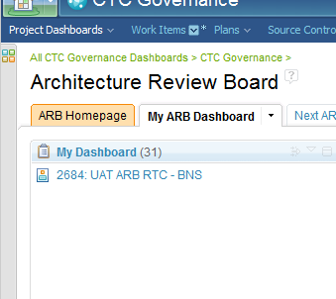
View/Update a Deliverable 1/2
Option 1. If you have just created the Deliverable, click on the Deliverable work item
Option 2. Use My ATA Dashboard to view all ATA items owned by you
Option 3. Use the search feature which is
available in the top right of every page

Slide 27
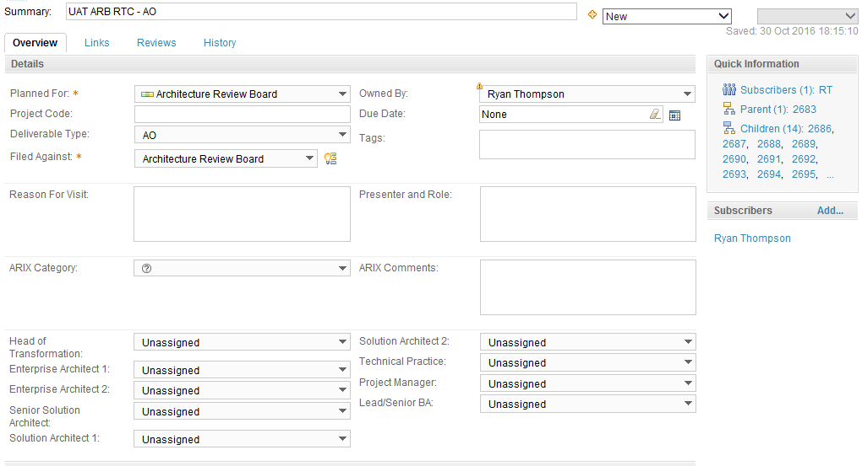
View/Update a Project 2/2
Project name
Current workflow state
Specify which meeting you wish to attend
Insert the project code
The main person responsible for updating the work item and attending ATA?
Pick the deliverable type
E.g. AO, HLOD or HLD
Governance body that is responsible for assessment
Why do you want to visit ATA/ARB?
Who will be attending and what is their role?
Subscribers receive notifications each time an update/change is made
What is the ARIX Category?
Specify the date when documents, checklists, presentation slides etc need to be uploaded
Who is involved in the project
Is the ARIX more Business or IT weighted or is there anything else influencing the category?
Add a brief description of the project
Always click Save after making any changes
Add project related comments. Admin also use for reminders and notes.

Slide 28
Attending an ARB or SDB

Slide 29
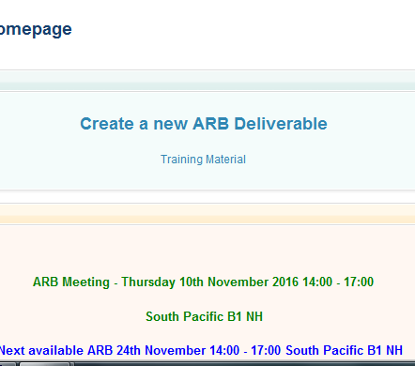
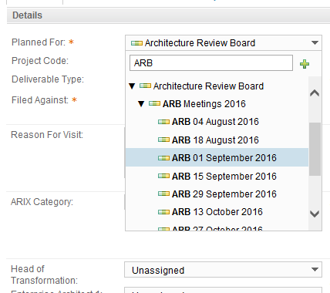
Attending an ATA, ARB or SDB 1/3
1. Ensure you have created a deliverable, either as part of a project or independently
See: Create a Project or Create a Deliverable
2. Open your Deliverable
See: View/Update a Deliverable
3. Specify which meeting you wish to attend by using the ‘Planned For’ field

Slide 30
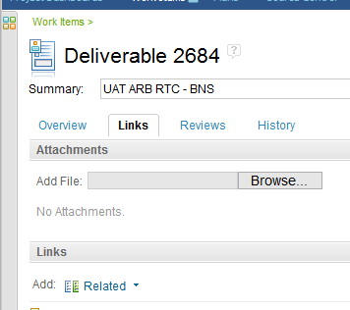
Attending an ATA, ARB or SDB 2/3
Deliverable 2683
HLD
4. Click on the ‘Links’ tab
5. Upload your slides or supporting material by clicking ‘Browse…’ and then navigating to the required file followed by clicking ‘Open’
Note: Repeat step 5 per file
6. Click on the ‘Overview’ tab

Slide 31
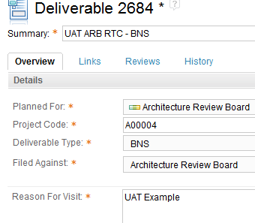
Attending an ATA, ARB or SDB 3/3
4. Update the workflow state from ‘New’ to ‘Request Admin Review’
5. Ensure you complete all mandatory fields as denoted by the orange asterisk
6. Click Save
Note: Changes only take affect when saved

Slide 32
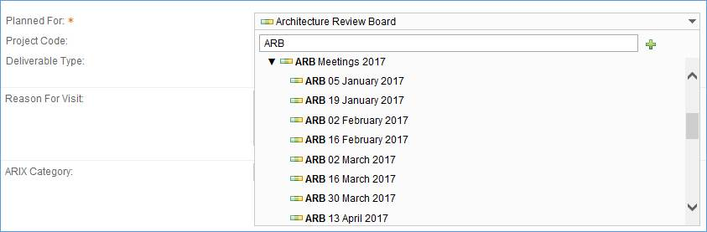
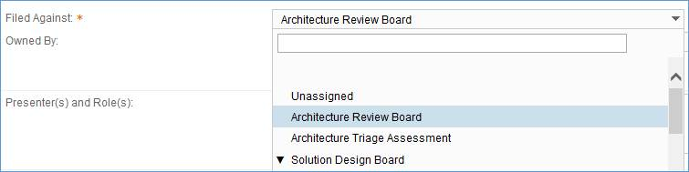
Hints and Tips – user RTC fixes
In order to assign an item to an ARB meeting, you need to update the Planned For and Filed Against, as well as completing all other mandatory fields (suggest setting status from New to Request Admin Review):
Planned For:
This is the date of the meeting you wish to attend. Type ‘ARB’ into the filter and you will be shown all ARB meeting dates.

Slide 33
Update/Resolve/Approve an Action

Slide 34
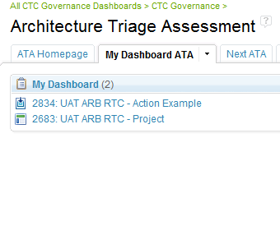
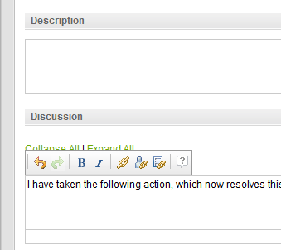
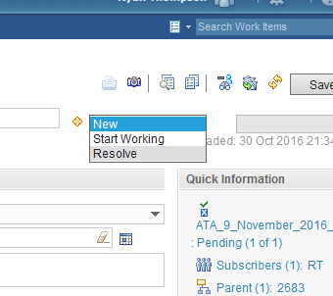
Update/Resolve an Action
1. Open the ‘My ATA/ARB/SDB Dashboard’
and click on the Action you wish to update
2. Add a comment to the ‘Discussion’ detailing any updates/actions taken
3. Update the workflow state from:
‘New’ to ‘In Progress’
or
‘New’ to ‘Resolved’
or
‘In Progress’ to ‘Resolved’

Slide 35
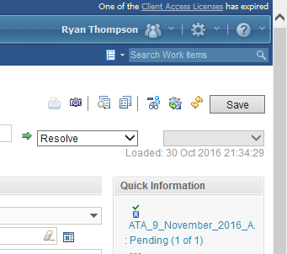
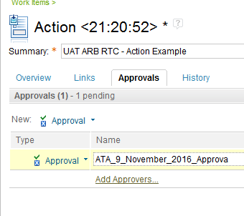
Update/Resolve an Action
4. Click Save
5. Ask the Senior Solution Architect to approve closure

Slide 36
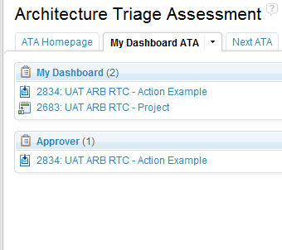
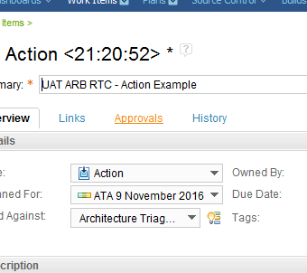
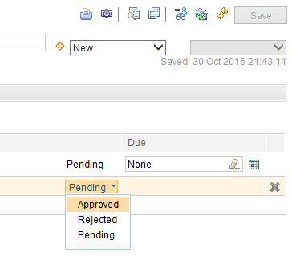
Approve an Action
1. Open the ‘My ATA/ARB/SDB Dashboard’
and click on the Action you wish to update
2. Click on the ‘Approvals’ tab
3. Update the approval state from ‘Pending’ to ‘Approved’ and Click Save
Note: Once the approval has been saved, the Action will be auto-completed/closed

Slide 37
Completing a Domain Review

Slide 38
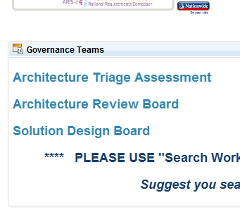
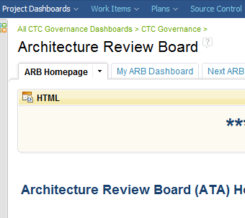

Completing a Domain Review 1/2
1. Access the ‘Architecture Review Board’ Homepage
2. Click on ‘My ARB Dashboard’
3. Select an AO/OS Domain Review which has been assigned to you

Slide 39


Completing a Domain Review 2/2
3. Fill in the Domain Review
4. Click Save

Slide 40

Hints and Tips – user RTC fixes
When entering the Head of Transformation, Project Manager or Project Sponsor name in the dropdown fields – Please enter SLTtrain1 in the dropdown, not all names are stored in RTC

